Slide 1


Data Preprocessing and Feature selection
Luis Miralles

Slide 2
Structure of the class
Example of CV application
Finishing the last week topic
Introduction to data processing
20 minutes break
Introduction to feature selection
Showcase example of valves in the ocean

Slide 3
Learning outcomes
How to approach a client
Why is it essential the KDD process?
Different steps in the KDD process
What is the preprocessing step?
Why feature selection is important
Discussion on how to select the best approach for data

Slide 4
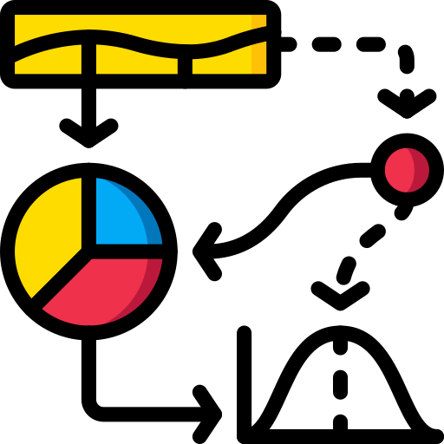
Section 1: Data preparation

Slide 5
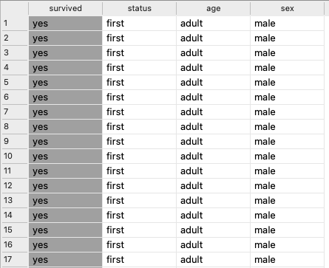
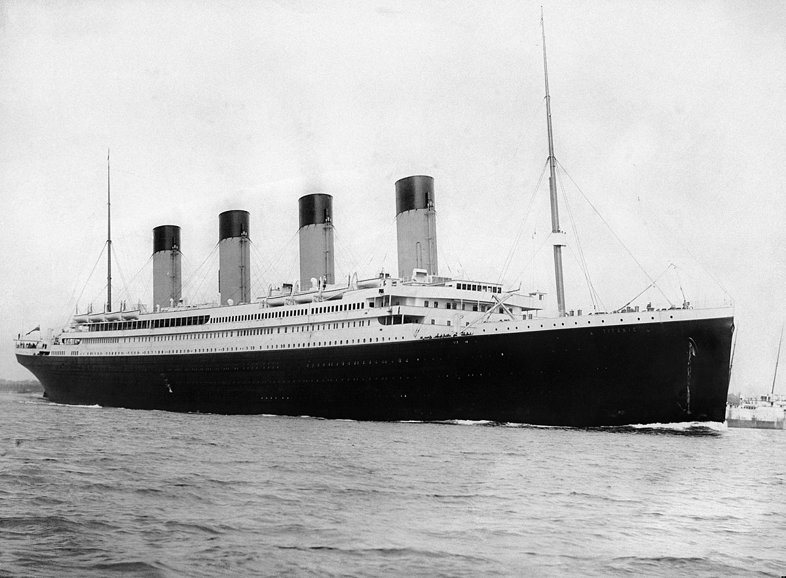
Example of the titanic dataset

Slide 6



Popular repositories for data mining
Kaggle repository: Competitions
UCI repository for machine learning.
https://datasetsearch.research.google.com/

Slide 7
Why data preparation is important?
This is important because we need to transform the information from our data sources into a format suitable for data mining tools.
Preparing the information is also relevant to improve the performance of the models
Data preparation can take around 70% of the workload of the data mining process

Slide 8

Problems of data in the real world
The data may be:
Incomplete: Many data need values for a column or many instances.
Noisy: Some of the values in the dataset will need to be clarified. For example: Age=”-11”, name = “2D4”, Telephone = “000”.
Inconsistency: The value is expressed in different forms. For example: “Ireland”, “Republic of Ireland”, “Eire”.

Slide 9

Typical tasks in data preparation
Data discretisation: Converts continuous data into a finite set of distinct intervals or categories.
Data cleaning: Remove noisy data (or soften it), replace missing values, smooth the outliers, and remove inconsistencies using the same value for all the variations.
Data integration: Merge all the different tables into a single table.
Data transformation:
Normalisation: Scaling the numbers within a range.
Aggregation: This is when you process information and leave a summary of it. For example, the number of items sold in a product or a country's average temperature or rain.
Data reduction: Eliminating unnecessary information to make more efficient and understandable models.

Slide 10
Types of attributes on a dataset
Qualitative is:
Nominals/categorical: Represent values or categories of things. Example: Attribute: colour, Values: {Red, Green, Blue…}.
Binary attributes: They can only have two values: Example: Attribute: Connected, State:{on, off}.
Ordinal attributes: Attribute: Grades, Values: {Heavyweight, Cruiserweight, Light Heavyweight, Super Middleweight, Middleweight, Super Welterweight}
Quantitative are:
Numeric: There are two types: interval-scaled (those that cannot be multiplied, e.g., temperature) and ratio-scaled (They are regular numbers).
Discrete: It has finite values. It can be numerical or categorical—for example, phone numbers.
Continuous: It can have infinite values, such as height or weight, but it is normally limited to a number of decimals.

Slide 11
Data conversion
Comparison: This is used when we need to compare results. For example, for grades, if you are using A+, A-, B+, B-... it would be best to use 4.0, 3.7, 3.3, 3.0… and so on.
Few instances: When you have classes with very few cases, consider merging them into one.
Outliers: They are values representing anomalies. You could apply different approaches, such as not doing anything, rescaling it to an upper/lower bound, or reducing it.
Normalisation: Some algorithms, such as Neural Networks, must have values between 0 and 1.

Slide 12
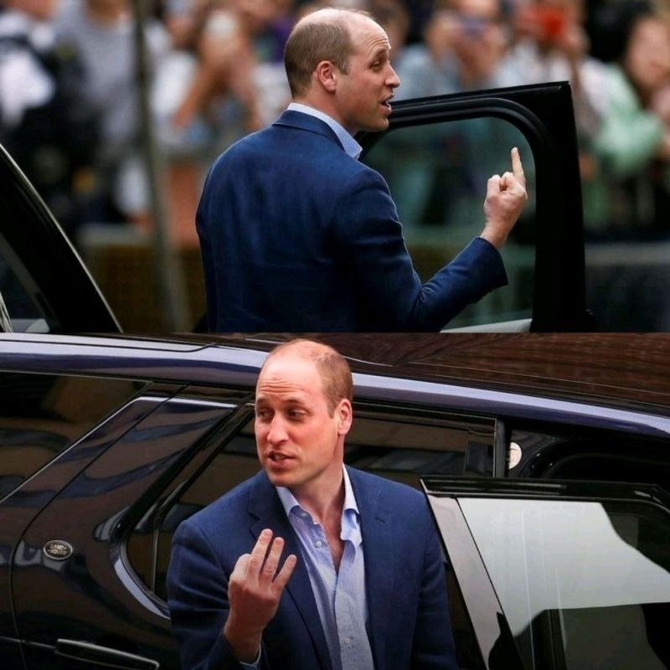
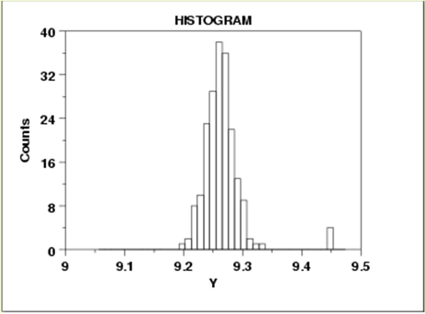
Look at the date from multiple perspectives
Sometimes, an outlier may be the consequence of erroneous information.
Seeing the data from only one perspective can be very dangerous. You need to compare.

Slide 13
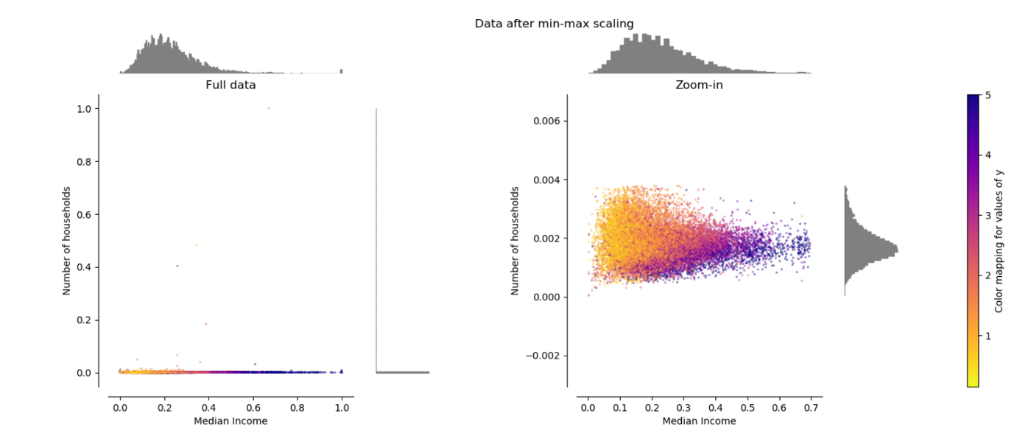
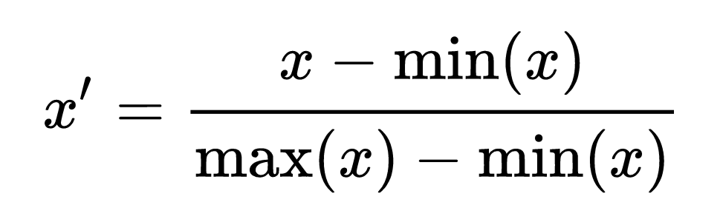
Normalization
Normalizing also helps to understand things in a better context.
Min-max normalisation is a very typical example.

Slide 14

Missing data – What to do?
Data may not be available in some tuples. Do we remove them or just replace them?
Data could be missing cause problems in the equipment, not properly written in the input, inconsistent with other values (inches, cm, metres…),
Some algorithms like RF can work with missing values. In others like NN you need to replace them with other values.
To replace missing values, you can use the mode in categorical data or the mean in numeric values.

Slide 15
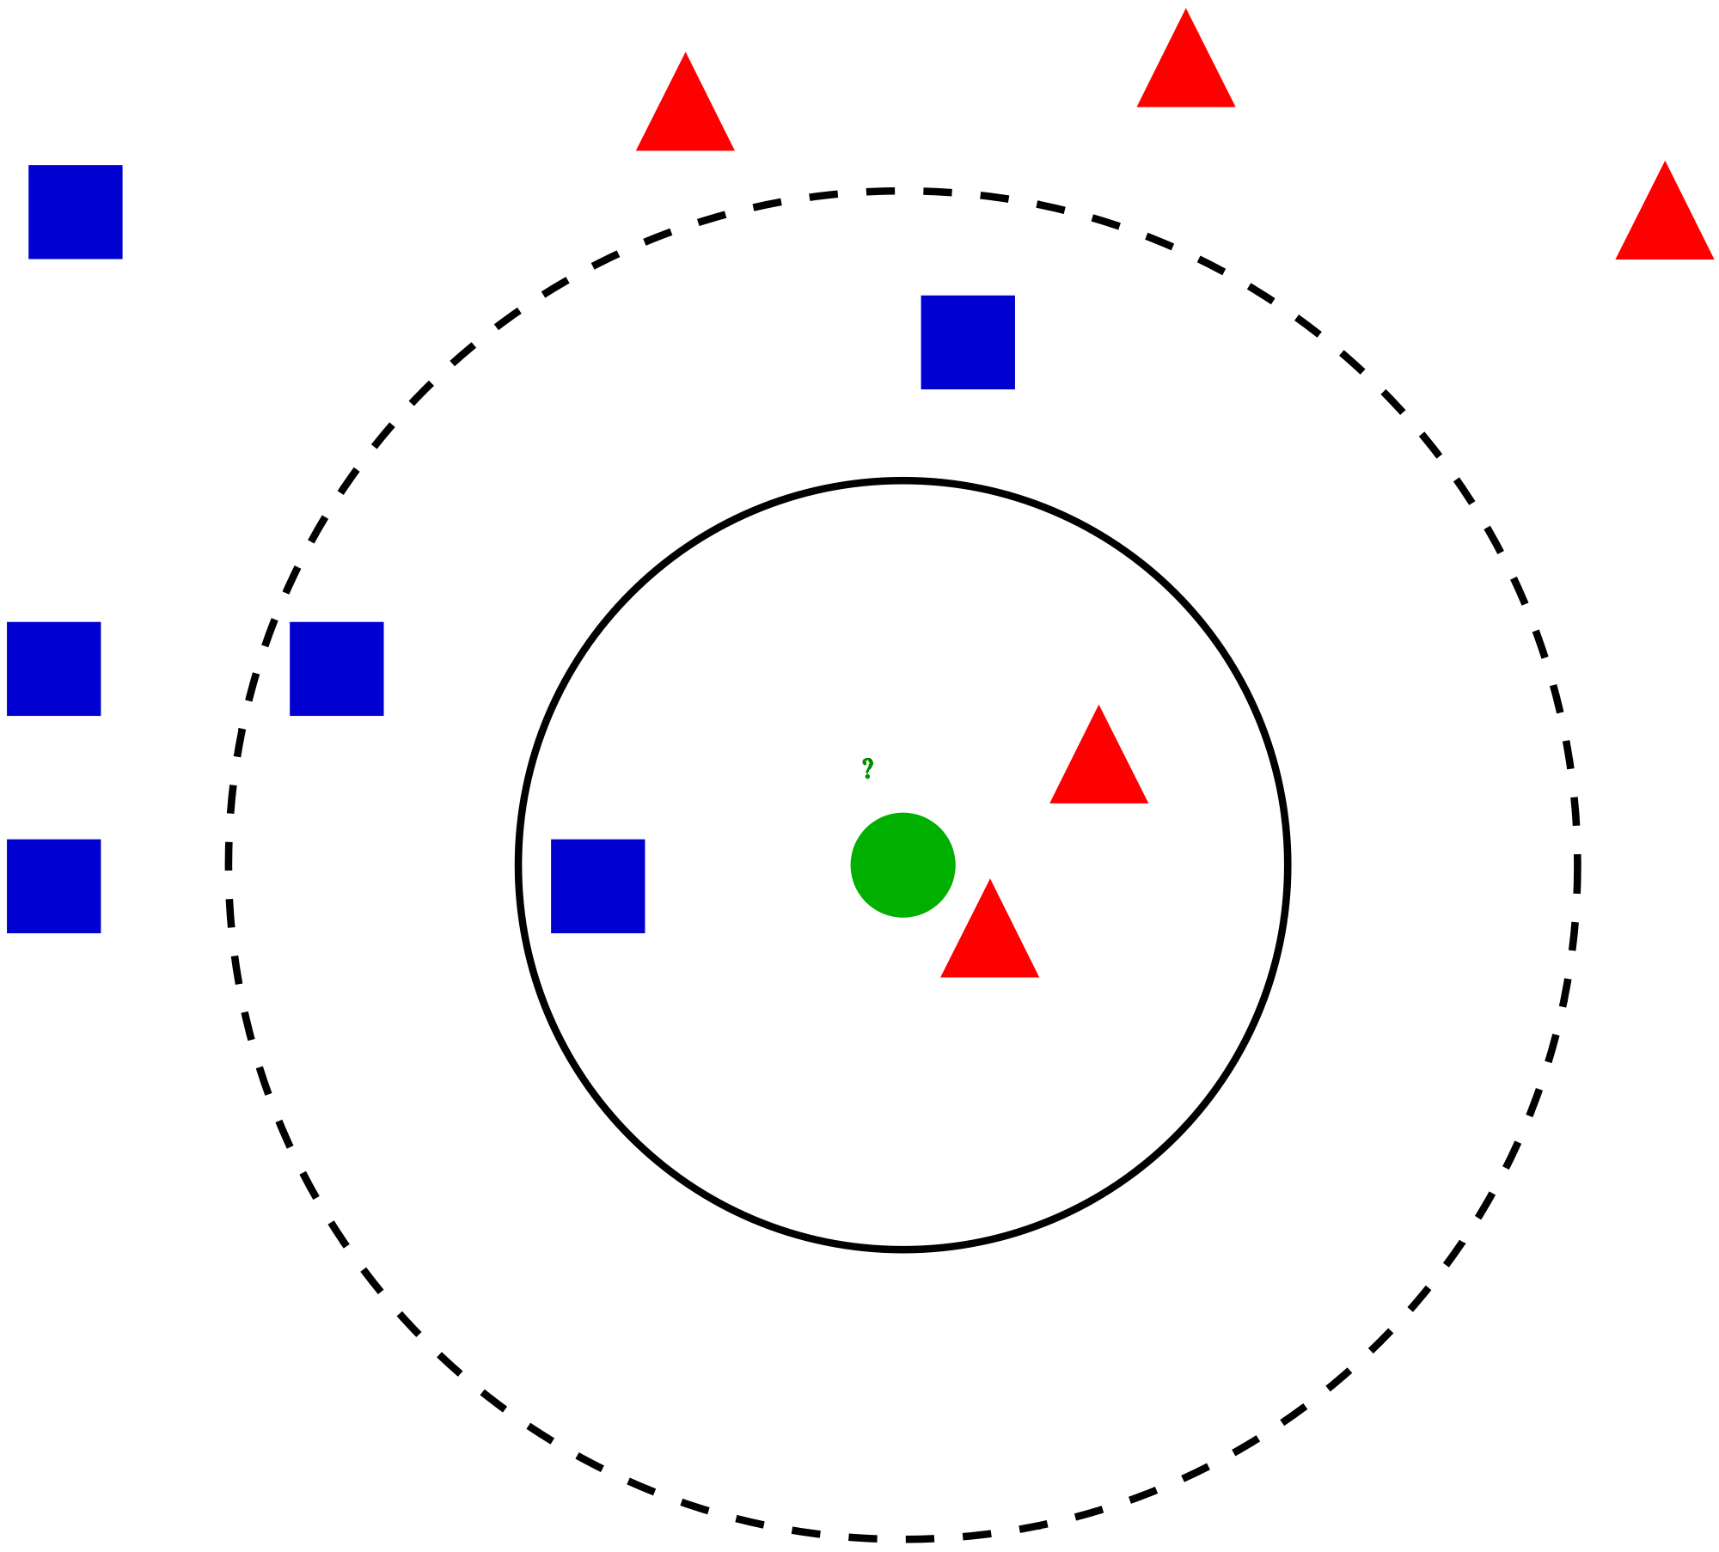
Missing data
We could also apply the K-nearest neighbour. In the image, the green point will take the value of the red triangle since it is closer to it.

Slide 16

Section 2: Feature selection

Slide 17

Feature Selection
What do you think are the main
advantages by order?

Slide 18

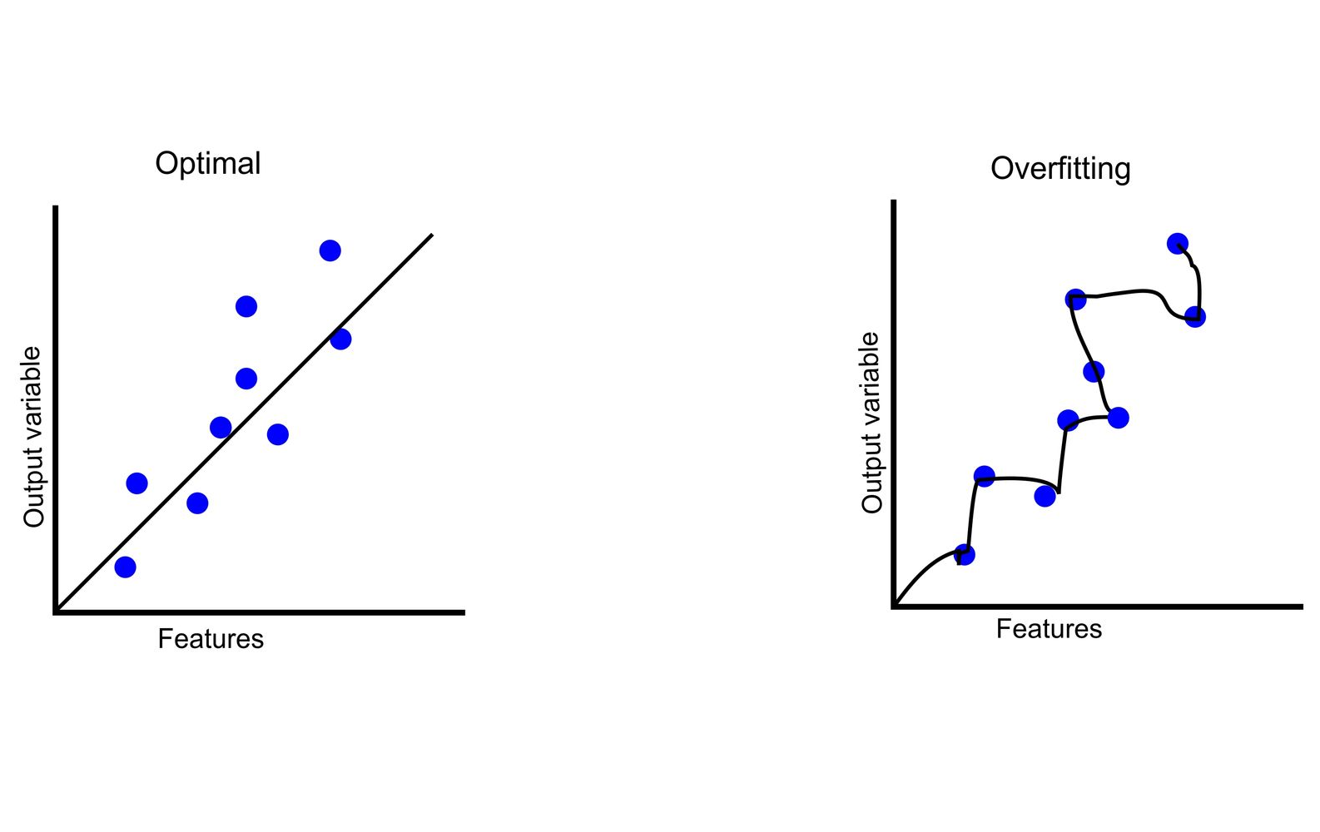
Feature selection
Understanding the data and finding valuable insights
It improves the interpretability of the methods
There is a difference between explainability and interpretability
Making models more accurate
Builds the models quicker and gets the output quicker
It also prevents overfitting.

Slide 19

There are many approaches to feature selection:
Filters rank the attributes of the dataset but do not build a model. They are typically univariate (analyse one attribute at a time) but can also be multivariate.
Wrapper methods build a model to evaluate the quality of a subset of methods.
Principal component analysis: This method creates new features based on approximation using linear combinations of the original features to reduce the number of features.
Deep Learning methods: We do not need to create variables because the method automatically does this for us.
What are the advantages of this method, and when would you use each method?

Slide 20
Pros and cons of each approach
Filters are quicker and more scalable because each feature can be executed independently. They are less likely to detect dependencies or redundancies between variables.
Wrapper methods are very computationally intensive, but they get the best results and can be helpful for interpretability.
PCA is speedy and reduces space. It created features that are very efficient and quick to process, but since variables are combinations, they are impossible to understand.
DL automatically selects features, but since it is a black box, we have no feedback on which features have been selected. Methods to generate explanations exist but are not 100% reliable and slow.

Slide 21
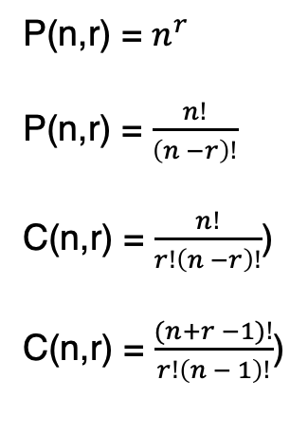
Combinations in Wrapper methods
Order matters
With repetition?
Formula
Yes (Permutation)
Yes (Permutation)
No (Combination)
No (Combination)
Yes
Yes
No
No
P(n,r) = $n^{r}$
P(n,r) = $\frac{n!}{\left(n −r\right)!}$
C(n,r) = $\frac{n!}{r!\left(n −r\right)!}$)
C(n,r) = $\frac{(n+r −1)!}{r!\left(n − 1\right)!}$)

Slide 22
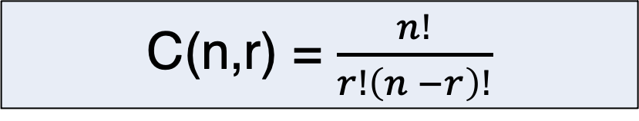
Combinations in Wrapper methods
If I have 100 features in wrapper methods. How many possible combinations of 10 do I have?
C(n,r) = $\frac{n!}{r!\left(n −r\right)!}$

Slide 23
Combinations in Wrapper methods
If I have 100 features in wrapper methods. How many possible combinations of 10 do I have?
The answer is: Overflow.
https://www.programiz.com/python-programming/online-compiler/

Slide 24
Python Code
# Online Python compiler (interpreter) to run Python online.
# Write Python 3 code in this online editor and run it.
import math
def combinations(n,r):
num = math.factorial(n)
den = math.factorial(r) * math.factorial(n-r)
return num/den
def total_combinations(n):
Total = 0
for i in range(1,n+1):
Total = Total + combinations(n,i)
return Total
Num_Variables = 100
for i in range(1,Num_Variables):
print(i, "has a total of ", total_combinations(i) , " combinations.")

Slide 25
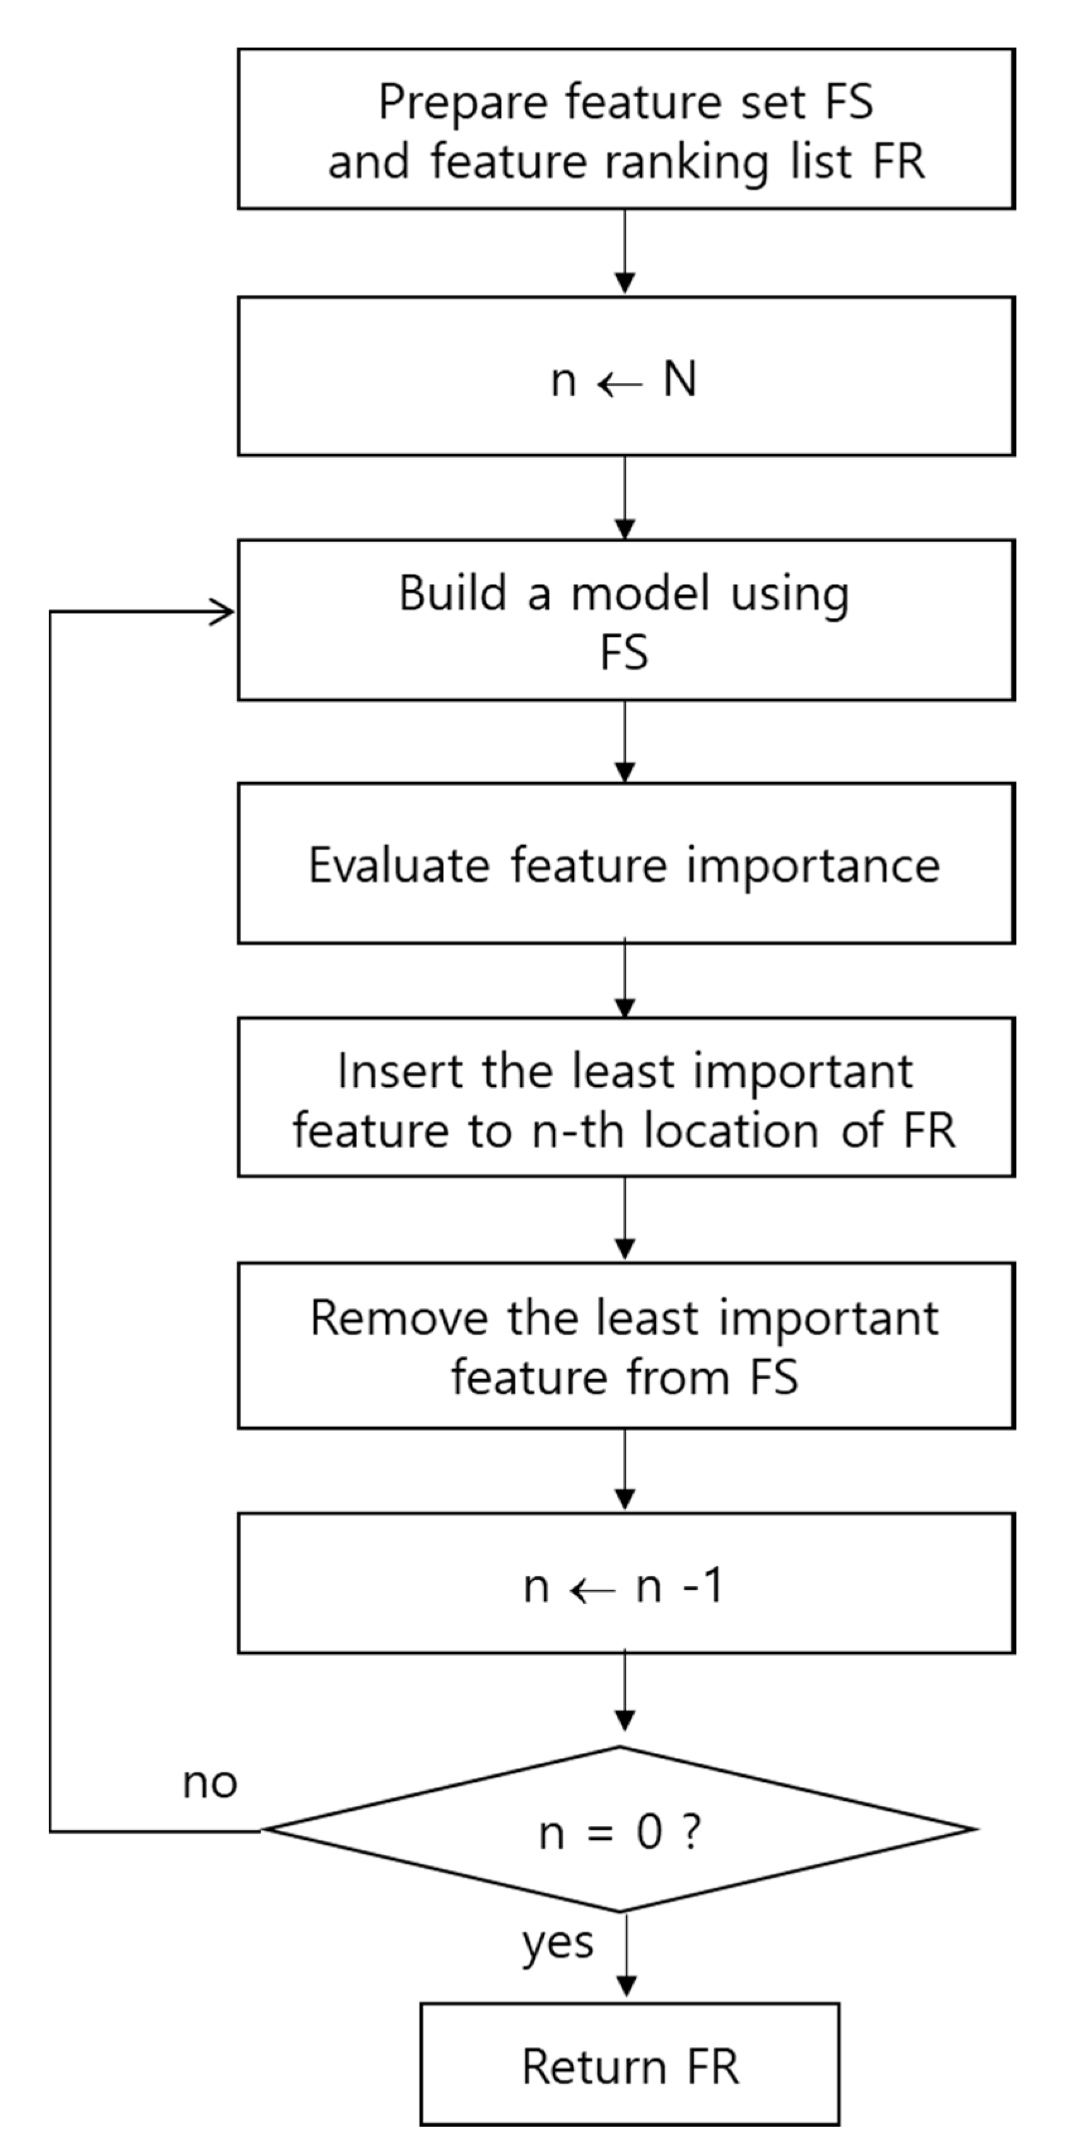
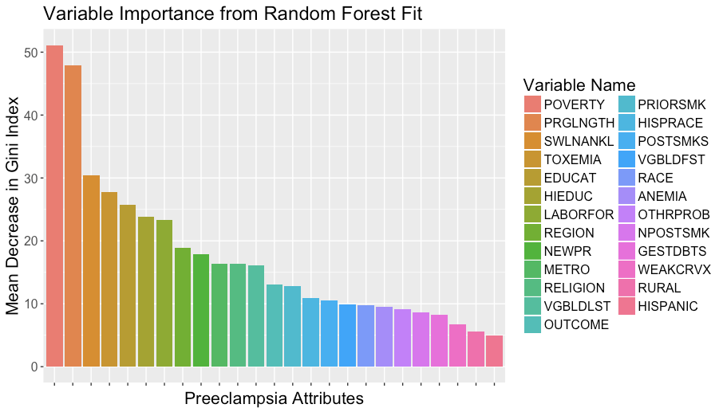
Feature selection in HAR using RFE
https://www.researchgate.net/publication/325800934_Decision_Variants_for_the_Automatic_Determination_of_Optimal_Feature_Subset_in_RF-RFE

Slide 26
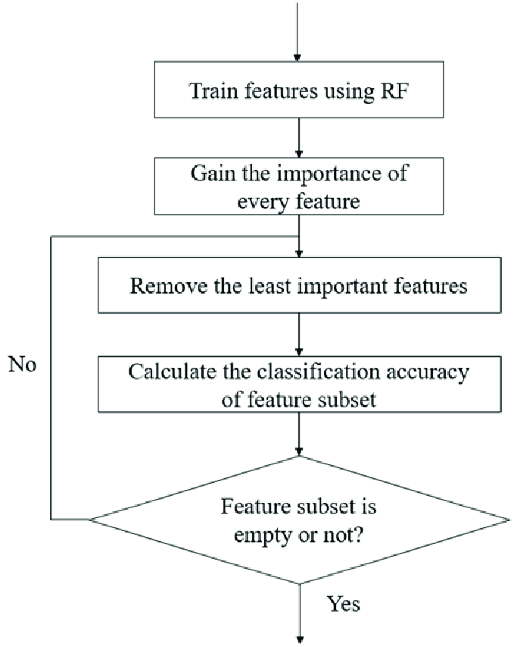
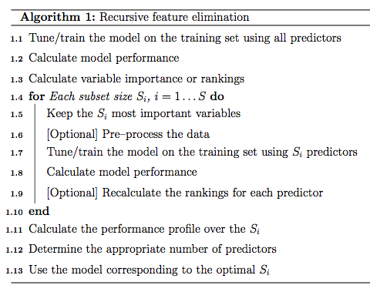
Feature selection in HAR using RFE

Slide 27
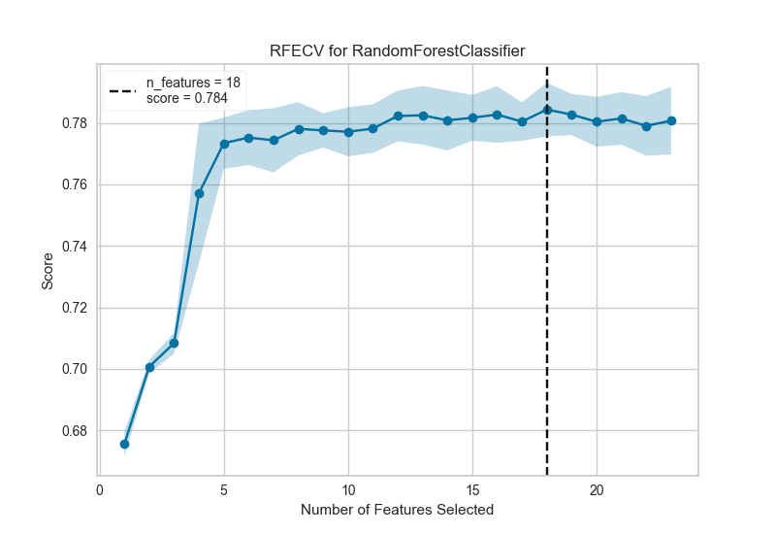
Recursive Feature Elimination
The model starts working with
all the features, and then it starts removing the less important features.

Slide 28
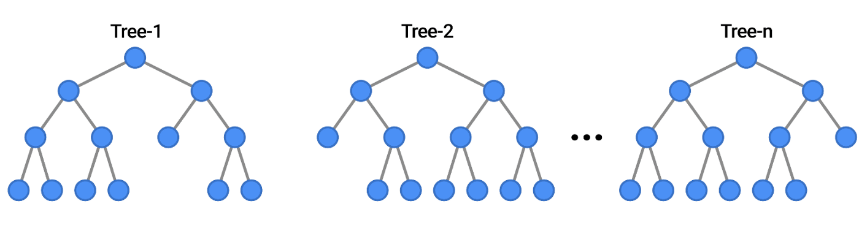
Random Forests Examples

Slide 29
What is PCA?
PC1
Principal component analysis is a dimensionality reduction method for large datasets.
The first step is standardisation for all values. Then calculates the covariance between all variables.
Input 2
PC2
Input 1
https://builtin.com/data-science/step-step-explanation-principal-component-analysis

Slide 30
The best projection is the one that has the largest variation

Slide 31
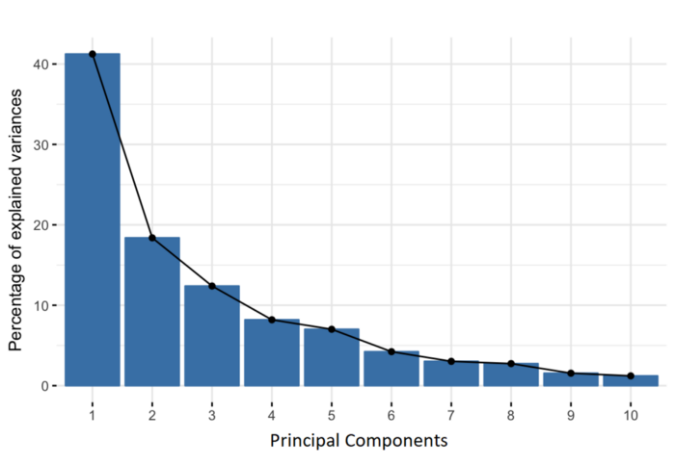
The PC1 new components are called eigenvectors
The Covariance matrix's eigenvectors are the axes' directions where there is the most variance.
And eigenvalues are simply the coefficients attached to eigenvectors.
Values are ranked by variance

Slide 32
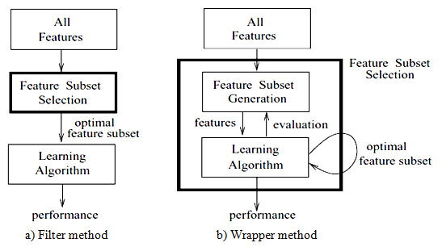
Difference between filter methods and wrapper methods
A genetic-based wrapper feature selection approach using Nearest Neighbour Distance Matrix
https://ieeexplore.ieee.org/document/5976534

Slide 33
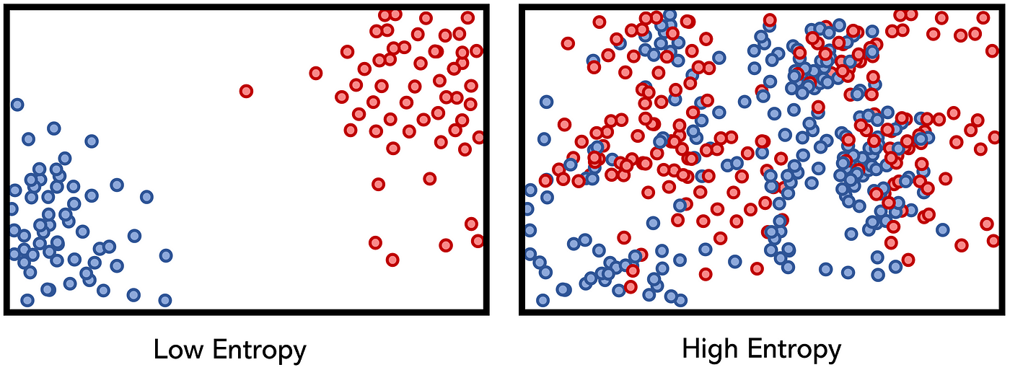
Filter methods - Information Gain
Entropy represents the state of disorder, randomness, or uncertainty.
https://www.saedsayad.com/decision_tree.htm

Slide 34
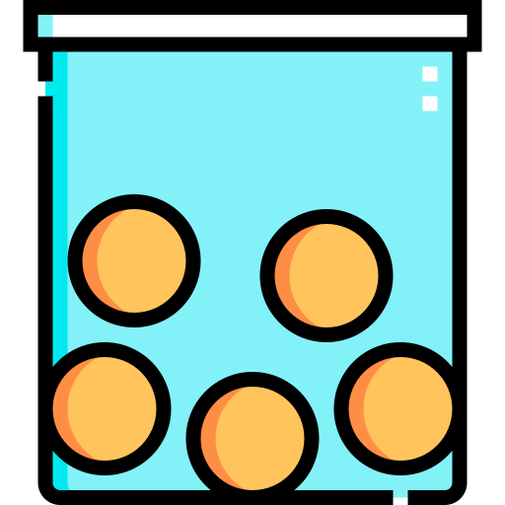
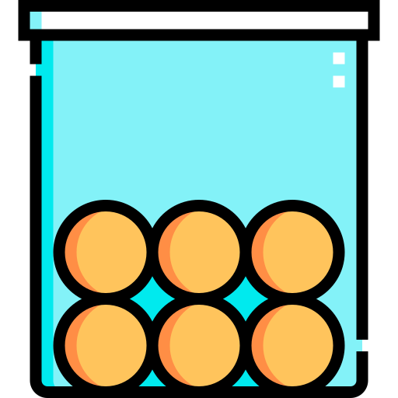
Section 3: Concept of Entropy for Feature Selection

Slide 35
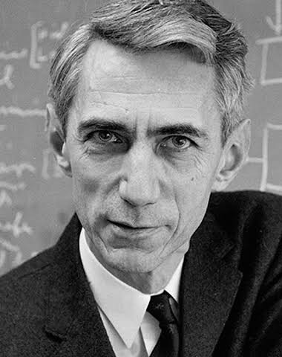
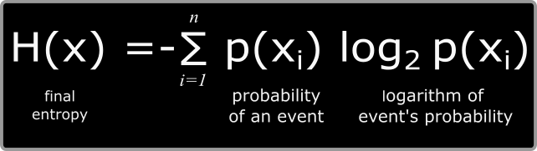
Introducing the Shannon entropy
Claude Shannon introduced the concept of information theory in 1948
Shannon entropy H(x) is primarily used to quantify the uncertainty in a probability distribution.
Σ represents the sum over all possible values of x in the distribution.

Slide 36
Introducing the Shannon entropy
Shannon entropy has several important properties:
It is always non-negative: H(X) ≥ 0.
It is minimised when one outcome is specific, and all others have zero probability. For example, if p(1) = 1 and p(x) = 0 for x ≠ 1, the entropy is zero (no uncertainty).
They are in logarithm base is 2, it is measured in bits. In this case, the unit of measurement is often called "bits of information."

Slide 37
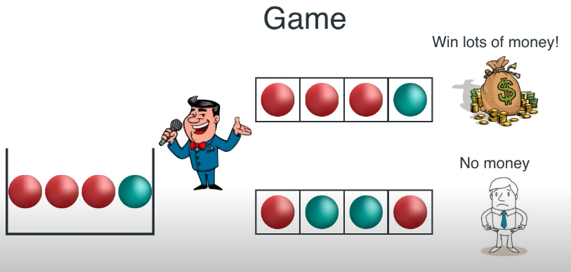
Game: The user wins if the balls are taken in the same order

Slide 38
Which is the best bucket to play with?
Box A
Box B
Box C
https://www.youtube.com/watch?v=9r7FIXEAGvs

Slide 39
Calculate the probability of getting this order
Box A

Slide 40
Calculating the probability of getting this order
Box B

Slide 41
Calculating the probability of getting this order
Box C

Slide 42
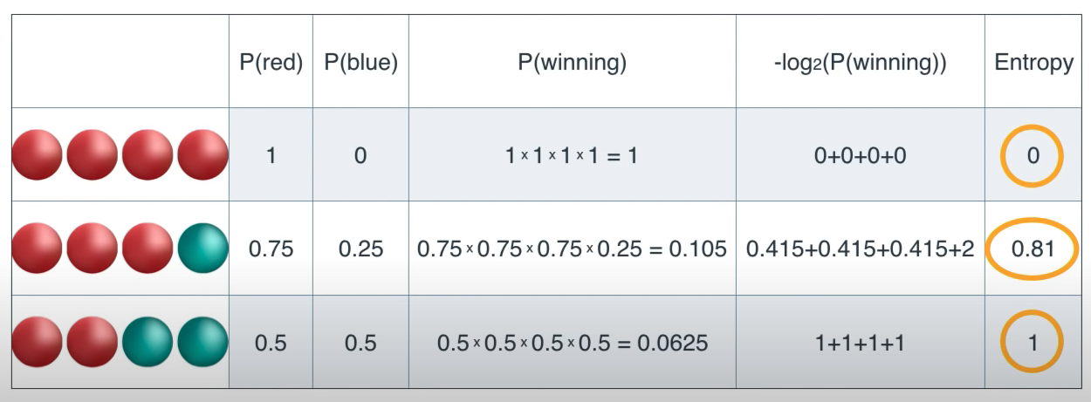
Calculating the probability of getting this order
Average

Slide 43
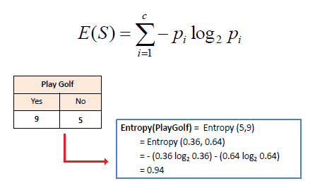
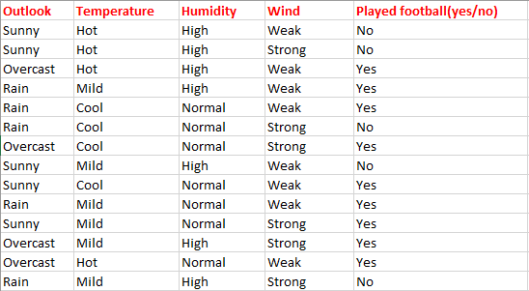
For calculating the Entropy we will use
Logarithms in base 2
9/14 = 0.64
5/14 = 0.357 = 0.36

Slide 44
Famous table for playing golf
Playing golf:
9 times yes
5 times no
9/14 = 0.64
5/14 = 0.357 ≈ 0.36
H(Playing Golf) = H(9,5) =
-(0.64 Log2 0.64) - (0.36 log2 0.36) = 0.94

Slide 45



Entropy Formula
Shannon-Entropy
Entropy with respect a given predictor
Information gain:
Decrease in entropy after a dataset is split

Slide 46
Famous table of playing golf
Playing golf:
9 times yes
5 times no
 |  | Play Golf
 |  | Yes | No
 | Sunny | 2 | 3
Outlook | Overcast | 4 | 0
 | Rainy | 3 | 2
E(PlayGolf, Outlook) = P(Sunny) E(2,3) + P(Overcast)E(4,0) + P(Rain) E(3,2) =
= (5/14x 0.971) + (4/14 x 0) + (5/14 x 0.971) = 0.6936

Slide 47
Information gain per class
IG = H(Play golf) - E(PlayGolf, Outlook) = 0.94 - 0.693 = 0.247
Information Gain(Outlook) = 0.247
IG(temperature) = 0.029
IG(Humidity) = 0.152
IG(Wind) = 0.048

Slide 48
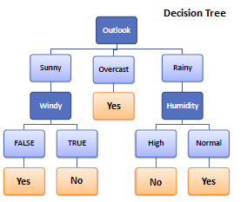
Decision tree structure

Slide 49
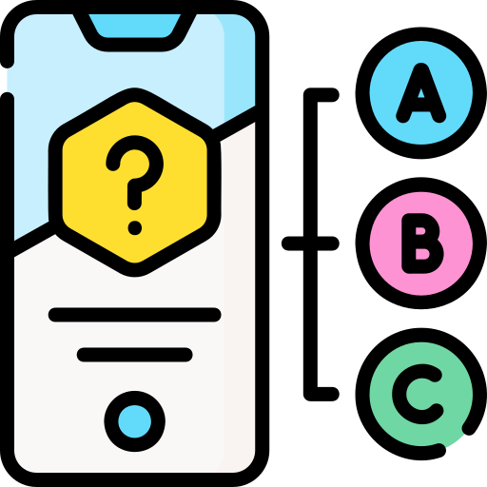
Section 4: Which approach would you use?

Slide 50
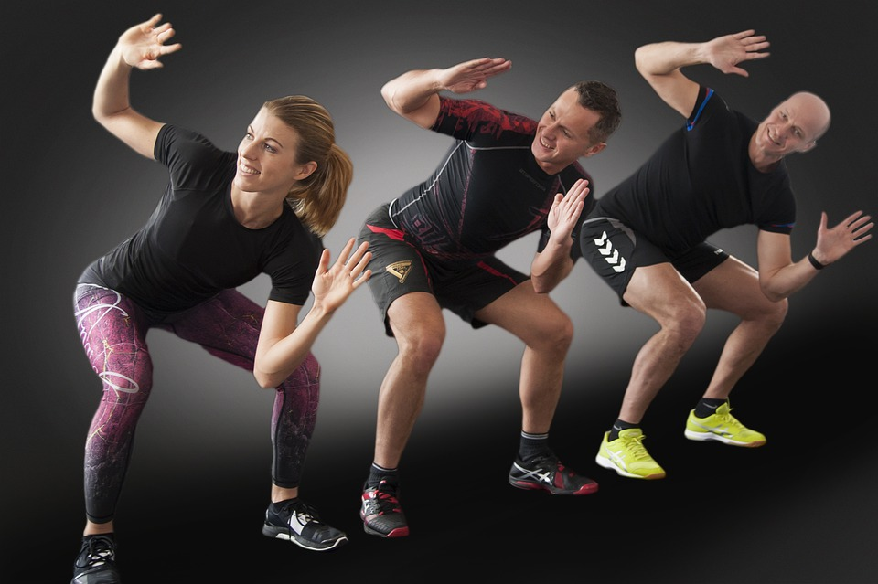
HUMAN ACTIVITY RECOGNITION
Imagine if we inserted a model inside a watch and we got 1000 points from 4 sensors. And you have 100k samples of 10 different users.
Filter
Wrapper
PCA
Deep Learning

Slide 51

ONLINE SALES OF A SHOP WITH 50 PRODUCTS
Imagine having an online shop with only 50 products, each with 100 features. We need to understand why some products are being sold more than others.
Filter
Wrapper
PCA
Deep Learning

Slide 52

ROUTE FOR IP INTERNET PACKAGE
Imagine we want to create a model for finding the best route over the internet. 1 Billion samples with 20 features each.
Filter
Wrapper
PCA
Deep Learning

Slide 53

GENE EXPRESSION STUDY
Imagine we are analysing genes for a scientific publication from 70 patients, and each gene has 20k different fields.
Filter
Wrapper
PCA
Deep Learning

Slide 54
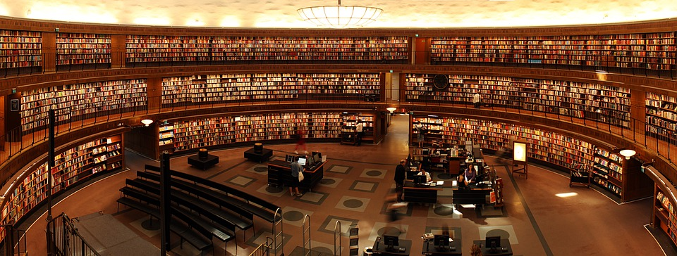
EXAMPLE OF A LIBRARY
Imagine a library with 20,000 books, each with 20 different fields. The university wants to know which books are less likely to be taken and why.
Filter
Wrapper
PCA
Deep Learning

Slide 55

RECOMMENDING AN ADVERT TO A USER
We have a dataset with 5 Million adverts (each with 25 fields), and we want to show the most accurate possible advert to maximise our model.
Filter
Wrapper
PCA
Deep Learning

Slide 56

PREDICTING THE WEATHER FORECAST
Imagine we have data from different sensors (temperature, pressure, wind, etc.) and 10 billion samples.
Filter
Wrapper
PCA
Deep Learning

Slide 57
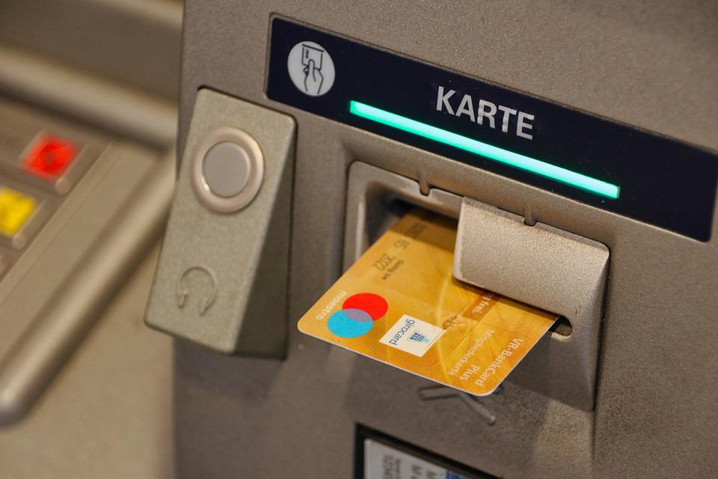
FRAUD DETECTION SYSTEM
Imagine we have 10 million transactions, and 0.05% of them are fraudulent.
Each transaction has 15 fields.
Filter
Wrapper
PCA
Deep Learning

Slide 58

CLINICAL ANALYSIS WITH CANCER
Imagine you have a dataset of 250 patients with 20 features.
Filter
Wrapper
PCA
Deep Learning

Slide 59
Decision Tree for deciding Feature Selection Method
Do I need to understand decisions?
Yes
No
Does it have a lot of features?
Do I need a small model or I have a small dataset?
Yes
No
No
Yes
Filter
Wrapper
PCA
Deep Learning

Slide 60
References
https://www.youtube.com/watch?v=9r7FIXEAGvs
https://www.geeksforgeeks.org/feature-selection-techniques-in-machine-learning/
https://ieeexplore.ieee.org/stamp/stamp.jsp?tp=&arnumber=7238499
https://www.slideshare.net/slideshow/principal-component-analysis-pca/264679594
https://www.cse.psu.edu/~rtc12/CSE586Spring2010/lectures/pcaLectureShort.pdf
https://www.stratascratch.com/blog/feature-selection-techniques-in-machine-learning/
https://machinelearningmastery.com/feature-selection-with-real-and-categorical-data/

